Slide 1

Data Handling and Functions

Slide 2
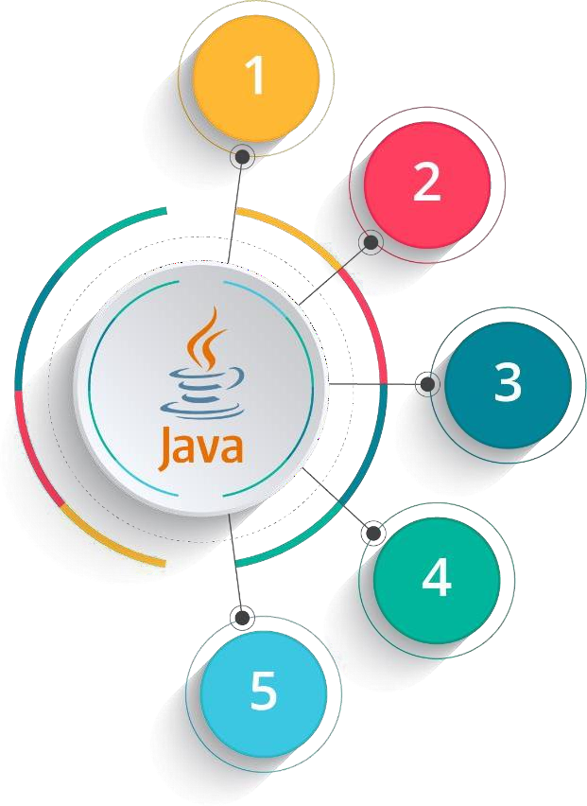
Course Outline
Introduction to Java
Data Handling and Functions
Object Oriented Programming in Java
Packages and Multithreading
Collections

Slide 3

Objectives
After completing this module, you should be able to:
Implement Single and Multi dimensional array
Declare and Define Functions
Call Functions by value and by reference
Implement Method Overloading
Use String data-type and String-buffer

Slide 4
Introduction to Arrays

Slide 5

Meet John Again
Remember John? Well, he is now grown up as a Programmer. He has managed to learn Java. Lets see how he is utilizing it.

Slide 6

One day in office..
Hello John and Daisy. You will be glad to know that we have received a very interesting project.
And I want you two
to work on it.

Slide 7
One day in office..
I will provide the document containing the details. Lets come up with a good solution.

Slide 8
John’s Project – Question Statement
Given below is the data on the votes for different parties, collected during elections in US
Serial no. | Region | Democratic Party | Republican Party
1 | Arizona | 126 | 152
2 | Florida | 32 | 85
3 | Vermont | 230 | 121
4 | Texas | 21 | 215
5 | Georgia | 200 | 13
The data is huge and given for many regions. John needs to find out the wining party
John takes a small dataset and works on it

Slide 9

Daisy was Confused!
John, How are you planning to go ahead with this?

Slide 10

John already had a Plan
?!!!!
We will be able to work easily on this using arrays!!

Slide 11

John came up with the Solution
And so, John started working on the Project and generated the solution.

Slide 12






John’s Solution
Georgia
Texas
Vermont Florida
Arizona
Democratic
Party
 |  | 0 | 1 | 2 | 3 | 4
 | 0 | 126 | 32 | 230 | 21 | 200
 | 1 | 152 | 85 | 121 | 215 | 13
j= 4
å
i= 0 , j= 0
=
votes(i, j) = 609
Republic Party
j= 4
å
i= 1 , j= 0
=
votes(i, j) = 586

Slide 13

John Presented the Solution
John, I am really very impressed by the way you handled this project. This is a very correct way of dealing with such problems.

Slide 14

John gets a Promotion!
Well done John. You have applied your skills very wisely. I am promoting you.

Slide 15



Arrays
An array is a data structure which holds the sequential elements of the same type
For Example: Lets create an array for Democratic party from John’s project
Array always starts from the index 0.
0 1 2 3 4
E.g: array index 4 is holding a value of 200
Democratic Party
126 32 230 21 200
Each index in the array holds a value.

Slide 16
Arrays
An array is a data structure which holds the sequential elements of the same type
For Example: Lets create an array for Democratic party from John’s project
Array always starts from the index 0.
0 1 2 3 4
E.g: array index 4 is holding a value of 200
Democratic Party
126 32 230 21 200
Each index in the array holds a value.
Why do we use Arrays?
Arrays are an important structure to hold data
Java allows us to hold many objects of the same type using arrays and it can be used with the help of a loop to access the elements by their index

Slide 17


Declaring Arrays
Array can be declared in multiple ways:
data type
size of array
Starts
 | 0 | 1 | 2 | 3 | 4
 | 0 | 0 | 0 | 0 | 0
Ends
1
int[]a= new int[5];
Index has to be given in
square brackets

Slide 18


Declaring Arrays
Array can be declared in multiple ways:
data type
size of array
Starts
 | 0 | 1 | 2 | 3 | 4
 | 0 | 0 | 0 | 0 | 0
Ends
1
int[]a= new int[5];
Index has to be given in
square brackets
data type
size of array
Starts
0 | 1 | 2 | 3 | 4
0 | 0 | 0 | 0 | 0
2
int a[]= new int[5];
Ends
Index has to be given in square brackets

Slide 19
Declaring Arrays
Array can be declared in multiple ways:
data type
size of array
Starts
 | 0 | 1 | 2 | 3 | 4
 | 0 | 0 | 0 | 0 | 0
Ends
3
int[]a= {1,2,3,4,5};
Index has to be given in
square brackets

Slide 20
Declaring Arrays
Array can be declared in multiple ways:
data type
size of array
Starts
 | 0 | 1 | 2 | 3 | 4
 | 0 | 0 | 0 | 0 | 0
Ends
3
int[]a= {1,2,3,4,5};
Index has to be given in
square brackets
data type
size of array
0 | 1 | 2 | 3 | 4
1 | 2 | 3 | 4 | 5
Starts
Ends
4
int[]a= new int[]{1,2,3,4,5};
Index has to be given in square brackets

Slide 21

Declaring Arrays (contd.)
Arrays can be declared for primitive and non-primitive data types

Slide 22
Declaring Arrays (contd.)
Arrays can be declared for primitive and non-primitive data types
Instead of declaring int a1, a2, a3, a4....a100, we can declare int a[100]

Slide 23
Declaring Arrays (contd.)
Arrays can be declared for primitive and non-primitive data types
Instead of declaring int a1, a2, a3, a4....a100, we can declare int a[100]
It is fast and efficient to access an element in an array using the corresponding
index without actually traversing through the entire array

Slide 24
Declaring Arrays (contd.)
Arrays can be declared for primitive and non-primitive data types
Instead of declaring int a1, a2, a3, a4....a100, we can declare int a[100]
It is fast and efficient to access an element in an array using the corresponding
index without actually traversing through the entire array
The size of the array is fixed once it is created

Slide 25
Declaring Arrays (contd.)
Arrays can be declared for primitive and non-primitive data types
Instead of declaring int a1, a2, a3, a4....a100, we can declare int a[100]
It is fast and efficient to access an element in an array using the corresponding
index without actually traversing through the entire array
The size of the array is fixed once it is created
For Example: A character array of 10 characters can be declared as
-
char[]ch= new char[10];

Slide 26



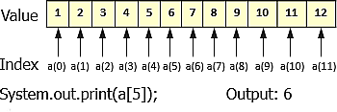

Types of Arrays
Single Dimensional Array
Multi Dimensional Array
Initialization:
int x[] = new int[12]
Initialization:
int x[][] = new int[5][5];
Index in dimension Y
0 1 2 3 4
0
1
2
3
4
Index in dimension X

Slide 27
How Single Dimensional Arrays are used?
Array can be initialized in this manner also:
class arrInit
{
public static void main (String[] args)
{
int i;
int[] a = {10, 20, 30, 40, 50};
for (i = 0; i < 5; i++) System.out.println (a[i]);
}
}
This program declares an array 'a' and initializes it with numbers 10, 20, 30, 40 and 50

Slide 28
Multi Dimensional Array
Multi dimensional arrays can be 2 dimensional as rows and columns similar to a matrix
It could be 3 dimensional with depth, height and breadth
Or it could be 'n' dimensional array as per the requirement
Usually 2 dimensional arrays are used to perform matrix operations
Like single dimensional arrays, multi dimensional arrays can be of primitive and non- primitive data type

Slide 29
Multi Dimensional Array
Multi-dimensional arrays can be declared as
int [][]a= new int [2][2];
char [][]a= new char[3][2];
float [][]a= new float[5][5];
2 x 2 dimensional int array
0
1
1 | 4
4 | 5
0
1
2 x 2 dimensional int array

Slide 30
Multi Dimensional Array
Multi-dimensional arrays can be declared as
int [][]a= new int [2][2];
char [][]a= new char[3][2];
float [][]a= new float[5][5];
x 2 dimensional int array
x 2 dimensional char array
0
1
0
1
0
s | a
g | v
v | d
0
1 | 4
4 | 5
1
1
2
2 x 2 dimensional int array
3 x 2 dimensional int array

Slide 31
Multi Dimensional Array
Multi-dimensional arrays can be declared as
int [][]a= new int [2][2];
char [][]a= new char[3][2];
float [][]a= new float[5][5];
x 2 dimensional int array
x 2 dimensional char array
5 x 5 dimensional float array
0
1
2
3
4
2.2 | 3.4 | 5.0 | 3.3 | 1.2
7.8 | 9.0 | 1.1 | 2.9 | 5.5
2.0 | 3.0 | 7.8 | 9.8 | 9.9
5.7 | 6.6 | 8.8 | 5.3 | 2.7
1.8 | 4.4 | 7.6 | 1.0 | 1.1
0
0
1
1
0
1
0
s | a
g | v
v | d
2
0
1 | 4
4 | 5
1
3
1
2
4
2 x 2 dimensional int array
3 x 2 dimensional int array
5 x 5 dimensional float array

Slide 32
Q
In Class Questions
1. How many bytes are allocated for the array x? int x[][] = new int[5][5];
2. Can we do multi dimensional array operations in single dimensional array? If yes, then why do we require
multi dimensional array?

Slide 33
A
In Class Questions - Solutions
How many bytes are allocated for the array x? int x[][] = new int[5][5];
Solution: An int element takes 4 bytes and array x can store 25 int elements. Hence total number of bytes taken
by x is 25*4 = 100
Can we do multi dimensional array operations in single dimensional array? If yes, then why do we require multi dimensional array?
Solution: We can perform all the operations of multi dimensional array in single dimensional array but when the data has more than one dimension, it will be easier to perform operations in multi dimensional array.

Slide 34
Function

Slide 35

Daisy seeks Help!
Hi John. I am having trouble in getting output for a Program. Jack told me I should use functions. What is a function? Can you please help me?

Slide 36

John helps Daisy
Yes sure. Do you see the coffee machine on the table?

Slide 37

John helps Daisy
Yes!!

Slide 38

John explain Functions
You just press a button and get coffee within seconds. There are a lot of processes running at the backend, but you do not implement them each time you need coffee. Instead you only get the output.

Slide 39

John explain Functions
Functions work in a similar way. It helps you save your time and effort while writing programs in Java. Let’s learn in details.

Slide 40
01
Functions
A function/method has group of statements to be
executed
02
A function has a task to perform
A function is declared as -
Scope specifier modifier return type function name (arguments)
public static void sayHello(int a, int b)

Slide 41
Why do we use Functions ?
Function name
It is the name given to the function. Using function name, functions can
be invoked.

Slide 42

Why do we use Functions ?
Function name
It is the name given to the function. Using function name, functions can
be invoked.
Scope specifier
This option specifies the visibility of the function. It could be public, private, protected or default (package)

Slide 43

Why do we use Functions ?
Function name
It is the name given to the function. Using function name, functions can
be invoked.
Scope specifier
This option specifies the visibility of the function. It could be public, private, protected or default (package)
Modifier
This will change the meaning of the function. Some of the options could be final, static, native, synchronized etc.

Slide 44

Why do we use Functions ?
Function name
It is the name given to the function. Using function name, functions can
be invoked.
Scope specifier
This option specifies the visibility of the function. It could be public, private, protected or default (package)
Modifier
This will change the meaning of the function. Some of the options could be final, static, native, synchronized etc.
Return type
This option specifies the data that
will be returned by the function. It could be primitive data type or object.

Slide 45

Why do we use Functions ?
Function name
It is the name given to the function. Using function name, functions can
be invoked.
Scope specifier
This option specifies the visibility of the function. It could be public, private, protected or default (package)
Modifier
This will change the meaning of the function. Some of the options could be final, static, native, synchronized etc.
Arguments
This is optional but can be used.
Using this, one can pass values to the
function for computation.
Return type
This option specifies the data that
will be returned by the function. It could be primitive data type or object.

Slide 46
Different kinds of Functions
We use functions to provide different kinds of functionality
For example:
absolute()
To find the absolute value of a number

Slide 47
Different kinds of Functions
We use functions to provide different kinds of functionality
For example:
absolute()
To find the absolute value of a number
square()
To find the square of a number

Slide 48
Different kinds of Functions
We use functions to provide different kinds of functionality
For example:
absolute()
To find the absolute value of a number
square()
To find the square of a number
sqrt()
To find the square root of a number

Slide 49

What happens when a Function is Invoked?
When a function is called from the main method, main method() address is stored on top of the
stack
01
01
Function
Invoke
02
03

Slide 50
What happens when a Function is Invoked?
When a function is called from the main method, main method() address is stored on top of the
stack
01
01
Function
Invoke
Control jumps to execute the
function
02
02
03

Slide 51
What happens when a Function is Invoked?
When a function is called from the main method, main method() address is stored on top of the
stack
01
01
Function
Invoke
Control jumps to execute the
function
02
02
03
After executing the function, main method address is popped from the stack and main method
execution resumes
03

Slide 52
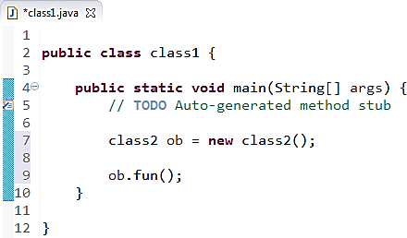


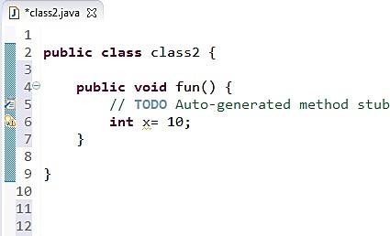
What happens when a Function is Invoked?
Stack
Step 1
ob(ref)
Heap ob Object
Ob(ref)

Slide 53
What happens when a Function is Invoked? (contd.)
Stack
Step 2
main (ref) Ob(ref)
Heap ob Object
Main
(ref)
Ob(ref)
Ob(ref)

Slide 54


What happens when a Function is Invoked? (contd.)
x = 10 main (ref) ob(ref)
Main (ref) Ob(ref)
Ob(ref)
Stack
Step 3
x = 10
main (ref) ob(ref)
Heap ob Object

Slide 55

What happens when a Function is Invoked? (contd.)
main (ref) ob(ref)
x = 10 main (ref) ob(ref)
Main (ref) Ob(ref)
Ob(ref)
Exiting Method
Stack
Step 4
fun()
main (ref) ob(ref)
Heap ob Object

Slide 56


What happens when a Function is Invoked? (contd.)
main (ref) ob(ref)
main (ref) ob(ref)
x = 10 main (ref) ob(ref)
Main (ref) Ob(ref)
Ob(ref)
Exiting Method main()
Stack
Step 5
main (ref) ob(ref)
Heap ob Object

Slide 57
Sample Program on Functions
Program to find square of a given number
public class testFunctions
{
//function to return square of a given number.
int static square (int x)
{
int y = x * x; return y;
}
public static void main (String[] args)
{
Scanner sc = new Scanner (System.in); System.out.println ("Please enter a number..."); int n = sc.nextInt();
int result = testFunctions.square (n); System.out.println ("Square of " + n + " is " + result);
}
}

Slide 58

Sample Program on Functions(contd.)
Program to find square of a given number
Stack
public class testFunctions
{
//function to return square of a given number. int static square (int x)
{
int y = x * x; return y;
}
Step 1
int n
public static void main (String[] args)
{
Scanner sc = new Scanner (System.in); System.out.println ("Please enter a number..."); int n = sc.nextInt();
int result = testFunctions.square (n); System.out.printl_{S}n_{te}(_{p}"Square of " + n + " is " + result);
}
2
}

Slide 59
Sample Program on Functions
Program to find square of a given number
public class testFunctions
{
//function to return square of a given number.
int static square (int x)
{
int y = x * x;
return y;
}
public static void main (String[] args)
{
Scanner sc = new Scanner (System.in);
System.out.println ("Please enter a number...");
int n = sc.nextInt();
int result = testFunctions.square (n);
} | } | System.out.println ("S_{S}q_{t}u_{e}a_{p}re of " + n + 2 | " is " + result);
Stack
Step 2
main(ref)
n

Slide 60
Sample Program on Functions (Contd.)
Program to find square of a given number
public class testFunctions
{
//function to return square of a given number.
Stack
Step 3
y x
main(ref)
n
int static square (int x)
{
int y = x * x;
return y;
}
public static void main (String[] args)
{
Scanner sc = new Scanner (System.in); System.out.println ("Please enter a number..."); int n = sc.nextInt();
int result = testFunctions.square (n); System.out.println ("Square of " + n + " is " + result);
}
Step
2
}

Slide 61
Sample Program on Functions (Contd.)
Program to find square of a given number
 | public class testFunctions
 | {
 | //function to return square of a given number.
 | int static square (int x)
 | {
 | int y = x * x;
 | return y;
 | }
k | public static void main (String[] args) {
 | Scanner sc = new Scanner (System.in);
 | System.out.println ("Please enter a number...");
 | int n = sc.nextInt();
 |  |  | int result = testFunctions.square (n);
 |  |  | System.out.println ("Square of " + n + " is " + result);
 |  | }
 | }
Stac
Step 4
result
y n

Slide 62



Function Calling Ways
Function Calling Ways
Call by Value
Call by Reference
When primitive data type is passed as an argument to the function it is call by value
If the Object of a class is passed as a parameter to a function then it is call by reference

Slide 63
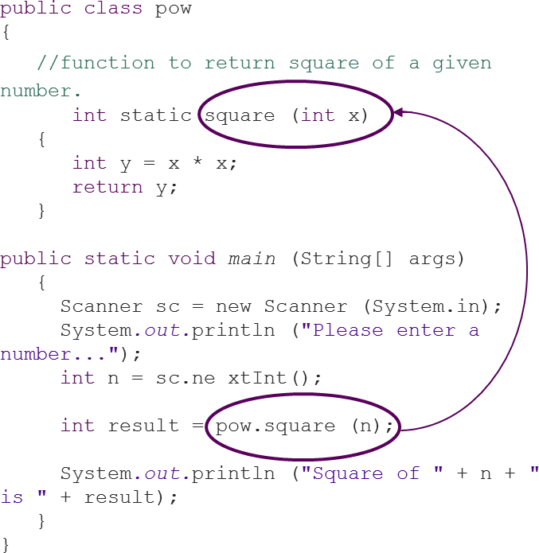
Call by Value
When value of the primitive data type is passed as an argument from the calling function, data is being sent to the function.
At the receiving end, a new variable is created and the data is copied. This is call by value.
All the programs we have done till now is done using call by value.

Slide 64

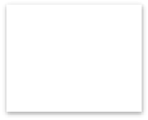

Call by Reference
When an object is passed as an argument to the function, its address is being passed so that any modification to the object will reflect in the object itself. This is call by reference.
Object
Any modification to the object will reflect in object
Passed as an
argument
Func
tion
Address is passed

Slide 65
Call by Reference
public class callByReference
{
int data=20;
public void functionDemo (callByReference test)
{
test.data = test.data * 2;
}
public static void main (String[] args){
callByReference c1 = new callByReference();
System.out.println ("Before calling the function : "+test.data);
Out of the program is
c1.functionDemo (c1);
System.out.println ("After calling the function : "+test.data);
}
}

Slide 66
Call by Reference
public class callByReference
{
int data=20;
public void functionDemo (callByReference test)
{
test.data = test.data * 2;
}
public static void main (String[] args){ callByReference c1 = new
callByReference();
System.out.println ("Before calling
the function : "+c1.data);
c1.functionDemo (c1);
System.out.println ("After calling the function : "+c1.data);
}
}
Out of the program is
Before calling the function: 20 After calling the function: 40

Slide 67





Polymorphism
Polymorphism means the system behaves differently in different programming context
Types of Polymorphism
Static
Polymorphism
Run Time Polymorphism
Function overloading is known as static time or compile time polymorphism
Inheritance is known as run time polymorphism

Slide 68
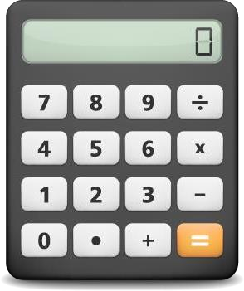
Function Overloading
Functions by different operators in a Calculator
÷ can divide:
→ two integers
→ two decimals
+ can add:
→ two integers
→ three integers
→ two decimals
→ three decimals

Slide 69

Function Overloading (contd.)
Addition is done using a function. If we did not have the concept of method overloading then the
calculator will have multiple plus buttons for the below tasks (each for a task):
→ | two integers | → | +
→ | three integers | → | ++
→ | two decimals | → | +++
→ | three decimals | → | ++++

Slide 70
Function Overloading (Contd.)
If many functions / methods have the same name but different arguments it is called Function Overloading
For Example:
If the user calls this method with integer data then the square method with
integer argument will be invoked
int square (int x);
Method name is same
double square(double x);
If the user calls this method with double data then the square method with double argument will be invoked.

Slide 71
Function Overloading (Contd.)
Function overloading does not depends on return type. It is differentiated only by the arguments of the
function.
For Example:
If the user creates two methods with same name and argument list but makes change in only return type then the method will not be overloaded and will result in syntax error
int square (int x);
Return type is
different
Method name and
argument is same
double square(int x);

Slide 72
Program on Function Overloading
public class FunctionOverloading
{
static int square (int x)
{
return x * x;
}
static double square (double x)
{
return x * x;
}
public static void main (String[] args)
{
int y = FunctionOverloading.square(10);
double z = FunctionOverloading.square (12.12); System.out.println("Square of 10 is " + y); System.out.println("Square of 12.12 is " + z);
}
}

Slide 73

Meet Mr. Letter and Miss Sentence!
Hi, my name is “Letter ”.
Hi, my name is “Sentence”

Slide 74

Mr. Letter is from “char datatype”
I have a space given by Java, which is “char” data type.
Ohh great! Can I come to your place?

Slide 75

Miss Sentence is sad!
I would love to! But it will be difficult for you to adjust there. It is simply not designed for you..
It makes me sad. So, Am I not required in Java?

Slide 76

Miss Sentence has her own Place in Java
Come on, don’t be sad. Everyone has their own place in Java. For you it is the “String datatype”

Slide 77

Why do we use String?
If we declare character arrays then we have to write string handling methods by ourselves like length of the string, copying string, getting part of the string (sub string) etc.
01

Slide 78





Why do we use String?
If we declare character arrays then we have to write string handling methods by ourselves like length of the string, copying string, getting part of the string (sub string) etc.
01
String class is given in Java to handle multiple characters / Strings and
02 many methods are given in this class to handle the Strings
Multiple Character
char
Single Character
String

Slide 79
String
String is a class in Java to store string data
You can assign string data simply by defining
the string object and assign the string like this:
You can concatenate two string using + symbol.
For Example:
String str1 = “Hello”;
String str2 = “World”; String str3 = str1 + str2;
System.out.println (“Concatenated string is : “+str3);
String str;
String str = “Dursikshya”;
String str = new String();
String str = new String(“Dursikshya");
Out of the program is

Slide 80
String
String is a class in Java to store string data
You can assign string data simply by defining
the string object and assign the string like this:
You can concatenate two string using + symbol.
For Example:
String str1 = “Hello”;
String str2 = “World”; String str3 = str1 + str2;
System.out.println (“Concatenated string is : “+str3);
String str;
String str = “Dursikshya”;
String str = new String();
String str = new String(“Dursikshya");
Out of the program is
Appended string is: HelloWorld

Slide 81
String Functions
length()
Returns the length
of the string
L
length()

Slide 82
String Functions (Contd.)
length()
charAt(int)
Returns the length
of the string
Returns a character
at the specified position. Index of the String starts from 0
L
length()
C
charAt(int)

Slide 83
String Functions (Contd.)
length()
charAt(int)
Returns the length
of the string
Returns a character
at the specified position. Index of the String starts from 0
L
length()
C
charAt(int)
concat (String str)
CO
concat (String str)
It concatenates the
with the string object. It is same as using '+' operator for concatenation

Slide 84
String Functions (Contd.)
length()
charAt(int)
Returns the length
of the string
Returns a character
at the specified position. Index of the String starts from 0
L
length()
C
charAt(int)
concat (String str)
equals(String str)
CO
concat (String str)
E
equals(String str)
It concatenates the
with the string object. It is same as using '+' operator for concatenation
Checks whether string object and str and return true if they are same else returns false

Slide 85
String Functions (Contd.)
EqualsIgnoreCase (String str)
Same as other function except that this function ignores the case and checks for the equality of the strings
E
EqualsIgnoreCase (String str)

Slide 86
String Functions (Contd.)
EqualsIgnoreCase (String str)
indexOf(String str)
Same as other function except that this function ignores the case and checks for the equality of the strings
Returns the index of the specified string in the string object
E
EqualsIgnoreCase (String str)
I
indexOf(String str)

Slide 87
String Functions (Contd.)
EqualsIgnoreCase (String str)
indexOf(String str)
Same as other function except that this function ignores the case and checks for the equality of the strings
Returns the index of the specified string in the string object
E
EqualsIgnoreCase (String str)
I
indexOf(String str)
R
replace(char ch, char ch1)
replace(char ch, char ch1)
Replaces the character ch with Character ch1 in the string

Slide 88
String Functions (Contd.)
EqualsIgnoreCase (String str)
indexOf(String str)
Same as other function except that this function ignores the case and checks for the equality of the strings
Returns the index of the specified string in the string object
E
EqualsIgnoreCase (String str)
I
indexOf(String str)
R
replace(char ch, char ch1)
replace(char ch, char ch1)
lastIndexOf(String str)
L
lastIndexOf(String
str)
Replaces the character ch with Character ch1 in the string
Checks whether string object and str and return true if they are same else returns false

Slide 89
String Functions (Contd.)
toLowerCase()
Converts the given
string to lowercase
T
toLowerCase()

Slide 90
String Functions (Contd.)
toLowerCase()
toUpperCase()
Converts the given
string to lowercase
Converts the given
string to uppercase
T
toLowerCase()
TO
toUpperCase()

Slide 91
String Functions (Contd.)
toLowerCase()
toUpperCase()
Converts the given
string to lowercase
Converts the given
string to uppercase
T
toLowerCase()
TO
toUpperCase()
trim()
TR
trim()
Removes the leading
and trailing spaces of
the string

Slide 92






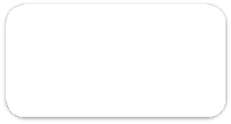

String Buffer
String Buffer
After Updation
String Buffer is also a Java class to store a string
Sb
Sb
String Buffer is mutable, that means the same StringBuffer object can be modified without new memory location
Heap
Heap
StringBufferObject
StringBufferObject
String is read only and immutable : This means, once the string object is defined and assigned a value, it cant be modified in the same memory location. If it is modified, then a new memory location is allocated for the new string object

Slide 93
Q
In Class Question
1. When should we use String and StringBuffer? why?

Slide 94
A
In Class Question - Solution
1. When should we use String and StringBuffer? why?
Solution: When we do not need to modify string objects then String can be used else using StringBuffer is a
better option since it is mutable.

Slide 95
Program on String Buffer
public class StringBufferDemo
{
public static void main (String[] args)
{
StringBuffer str1 = new StringBuffer ("Hello"); StringBuffer str2 = new StringBuffer ("World");
str1.append(str2);
System.out.println("Appended string is : "+str1);
}
}

Slide 96
Program on String Buffer
public class StringBufferDemo
{
public static void main (String[] args)
{
StringBuffer str1 = new StringBuffer ("Hello"); StringBuffer str2 = new StringBuffer ("World");
str1.append(str2);
System.out.println("Appended string is : "+str1);
}
}
Out of the program is
Appended string is: HelloWorld

Slide 97
String Builder
String Builder is same as String Buffer except that String Builder is not thread safe(not Synchronised)
That means data is not safe when multiple threads run at the same time
For Example: The following code:
StringBuilder sb = new StringBuilder(); // creates empty builder, capacity 16
sb.append("Greetings"); // adds 9 character string at beginning

Slide 98
String Builder
String Builder is same as String Buffer except that String Builder is not thread safe(not Synchronised)
That means data is not safe when multiple threads run at the same time
For Example: The following code:
StringBuilder sb = new StringBuilder(); // creates empty builder, capacity 16
sb.append("Greetings"); // adds 9 character string at beginning
will produce a string builder with a length of 9 and a capacity of 16. String builder with a length of 7 and a capacity of 16 is shown below:
capacity () = 16
0
1 2 3
4
5 6
7 8 9 10 11 12 13 14 15
e
d
u
r
e
k a
length () = 7

Slide 99
String Builder Constructors
StringBuilder Constructors
Constructor | Description
StringBuilder() | Creates an empty string builder with a capacity of 16 (16 empty elements).
StringBuilder(CharSequence cs) | Constructs a string builder containing the same characters as the specified CharSequence, plus an extra 16 empty elements trailing the CharSequence.
StringBuilder(int initCapacity) | Creates an empty string builder with the specified initial capacity.
StringBuilder(String s) | Creates a string builder whose value is initialized by the specified string, plus an extra 16 empty elements trailing the string.

Slide 100
Assignment – Single Dimensional Array
Program to find the largest element in the array
Program to search an element in the array. Take the data from the user using scanner class
Program to sort an array in the ascending order
Program to display second largest element in the array with and without sorting the array
Program to reverse the elements of the array

Slide 101
Assignment – Two Dimensional Array
Program to add, subtract two dimensional array of 2 x 2 matrix
Program to transpose a matrix
Program to add all the elements of the matrix

Slide 102
Assignment – Functions
Write a program to find the cube of a number
Write a program to find factorial of a number
Write a program to reverse the digits of a number
Write a program to check given string is palindrome or not
Write a program to check given number is even or odd
Write a program to generate 'n' Fibonacci numbers
Write a program to check given number is prime or not
Write a program to swap two numbers

Slide 103
Assignment – Functions Overloading
Write a program to cube of an integer and double values using function overloading
Write a program to print integer and String data using function overloading

Slide 104
Assignment
1. Write a program to accept 5 employee ids and the corresponding names and their salaries from the user and store them in three arrays. Pass these arrays to a function display() as arguments. This display() will display the content of the arrays in the following format.
ID | Name | Salary
00 | Divya | 600000
002 | Shresta | 550000
003 | Charan | 500000
004 | Vineet | 500000
005 | Jabbar | 300000

Slide 105
Assignment (Contd.)
2. Write another function display() with Employee ID array and Employee name array as arguments. (Note: here we are using concept of function overloading). This function will display the content of the 2 arrays in the below given format.
ID | Name
00 | Divya
002 | Shresta
003 | Charan
004 | Vineet
005 | Jabbar

Slide 106
Assignment (Contd.)
3. Write another function named display() which takes 4 arguments. The arguments are name as String and 3
arrays (Employee id, name and salary). Function prototype looks as given below:
display (String name, int regno[], String Empname[], double salary[]).
This function will search for the name in the Empname array and will display its corresponding id and salary in
the below given format. For example, if Divya is given as the name to search then display () function will display
the following record.
ID | Name | Salary
00 | Divya | 600000
Note: main() should have the following steps-
Declaring the arrays.
Accepting data for the arrays.
Calling the 2 display() functions which takes 3 and 2 arguments.
Accept a user name to search in the array and display the record by calling the display() function which takes 4 arguments.

